Slide 1
Working with a Supermodel for SharePoint
Sonja Madsen
Notes:
This slide is mandatory. Please do not remove.

Slide 2

Sonja Madsen
Owner
SONJASAPPS
sp2013.blogspot.com
@sonjamadsen
SharePoint MVP, Best International Developer

Slide 3
SharePoint Add-ins
SharePoint Framework
Set up
Deployment
Working with SharePoint lists and libraries
Office UI Fabric
Set up
Deployment
Working with SharePoint lists and libraries
Office UI Fabric

Slide 4
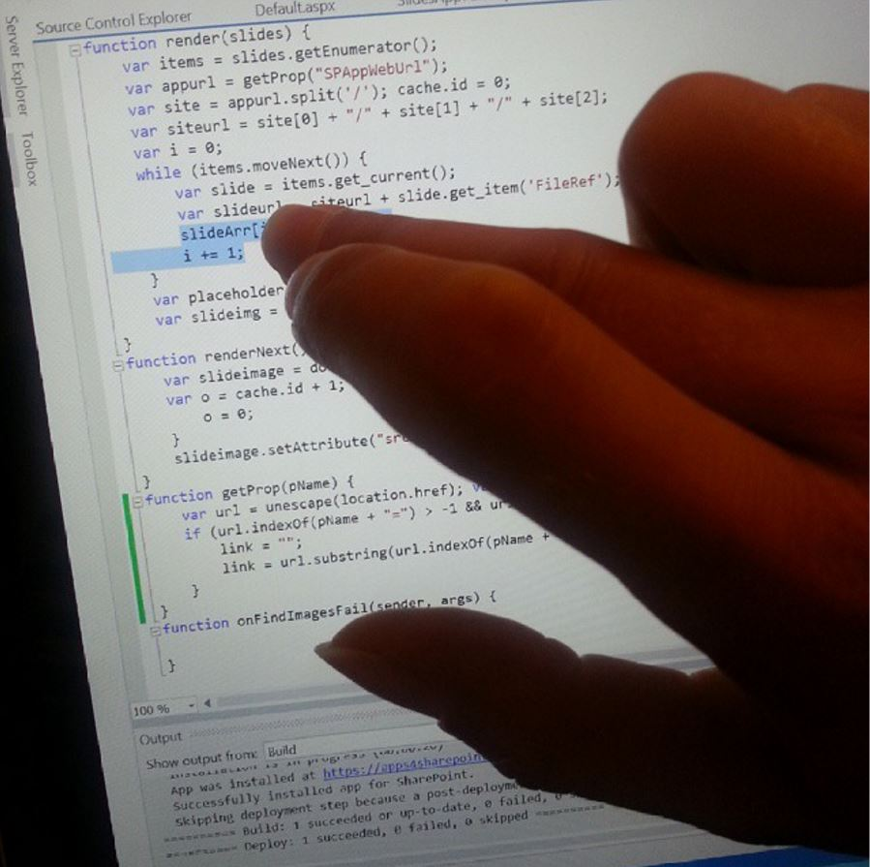

SharePoint add-in and Office 365
&
Visual Studio
Developer Site

Slide 5
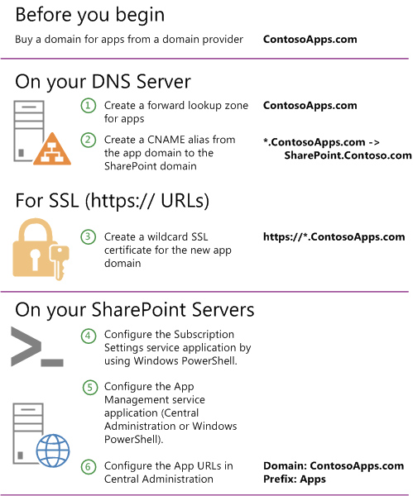

SharePoint add-in and SharePoint on-premise
SharePoint add-in and SharePoint on-premise
&
&
Visual Studio
Developer Site

Slide 6

SharePoint add-in, Deployment
Corporate App Catalog
SharePoint App Store
SharePoint Add-in

Slide 7



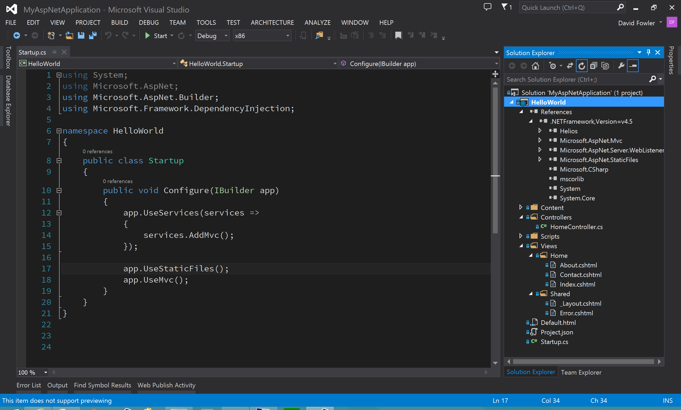

SharePoint Add-in .app package
.app
.xml
.js
.css
.jpg
.wsp
Content
Scripts

Slide 8


SharePoint add-in, .js, .css files, images
CDN or remote server
Scripts folder or SharePoint library

Slide 9


Slide 10
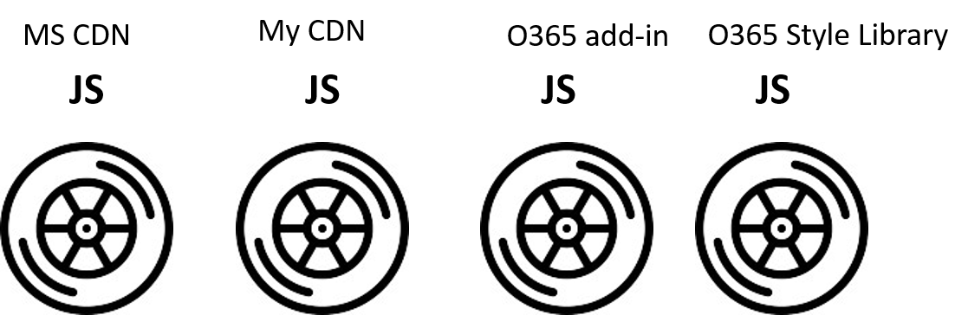

Slide 11
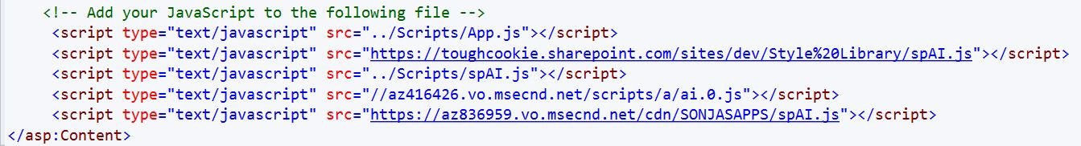

Slide 12
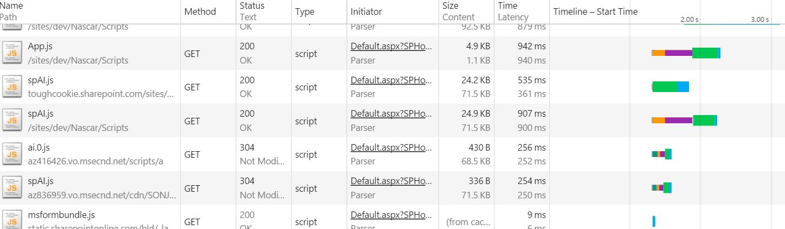
Style Library 535ms
SharePoint add-in Scripts folder 907ms
MS CDN 256ms
My CDN 254ms

Slide 13
Web Parts and Applications

Slide 14
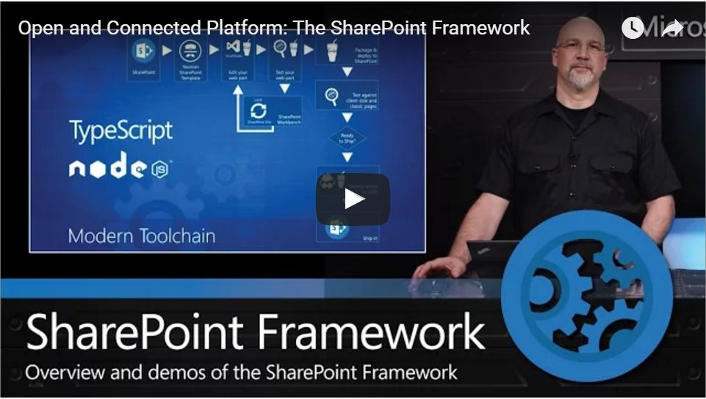

Slide 15
SharePoint web part and Office 365
&
&
LOCAL HOST
Visual Studio Code
Or
Visual Studio
Workbench
SharePoint

Slide 16
SharePoint web part and SharePoint on-premise
&
&
LOCAL HOST
Workbench
Visual Studio Code
SharePoint

Slide 17
SharePoint web part, Deployment
Corporate App Catalog
TBD - SharePoint App Store
SharePoint web part

Slide 18
SharePoint Web Part .spapp package
.spapp
.xml
.js
.css
images
Bundle

Slide 19
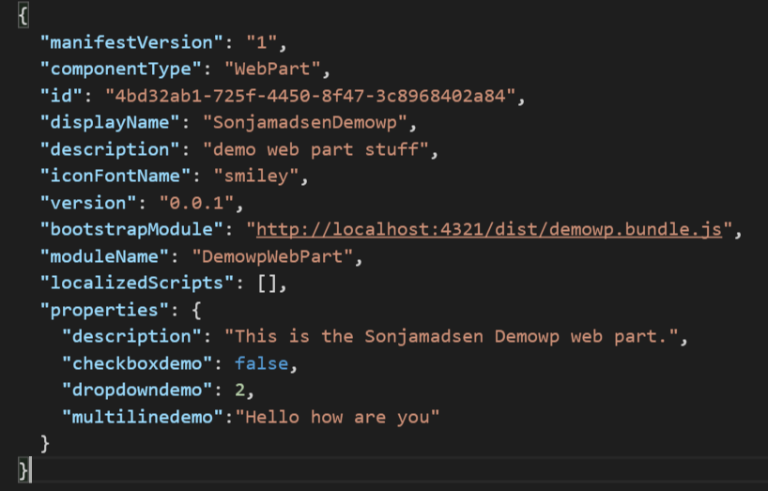
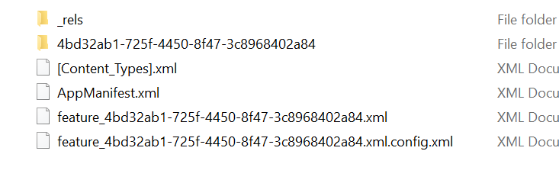
SharePoint web part .spapp
No .wsp, no .js, no .css, no images

Slide 20
Development
Visual Studio Code
TypeScript
React is a suggested framework
Office UI Fabric

Slide 21
Web Part
Main page

Slide 22

SharePoint Framework
Euroean Premiere
DEMO

Slide 23
List-based Applications
New item, Edit item, Display item
A list with custom list form pages
Main page
Any other page

Slide 24
Page-based Applications
Pages
Site Pages Library

Slide 25
Webhooks
List item receivers
Add item, delete item, check-out, check-in

Slide 26
SharePoint Add-ins - Advantages
You can hide the lists from end-user
Both pages and an app part
.aspx page – HTML
Images, scripts, stylesheets hosted on SharePoint
Isolated is not always a bad thing

Slide 27
SharePoint Framework - Advantages
Responsive mobile friendly
No iframe
Dynamic properties
Webhooks
List-based and Page-based
No need for cross-domain library to access SharePoint resources

Slide 28
Office UI Fabric
http://dev.office.com/fabric/styles
Fonts, colors, message colors
Grid
Icons
Controls

Slide 29
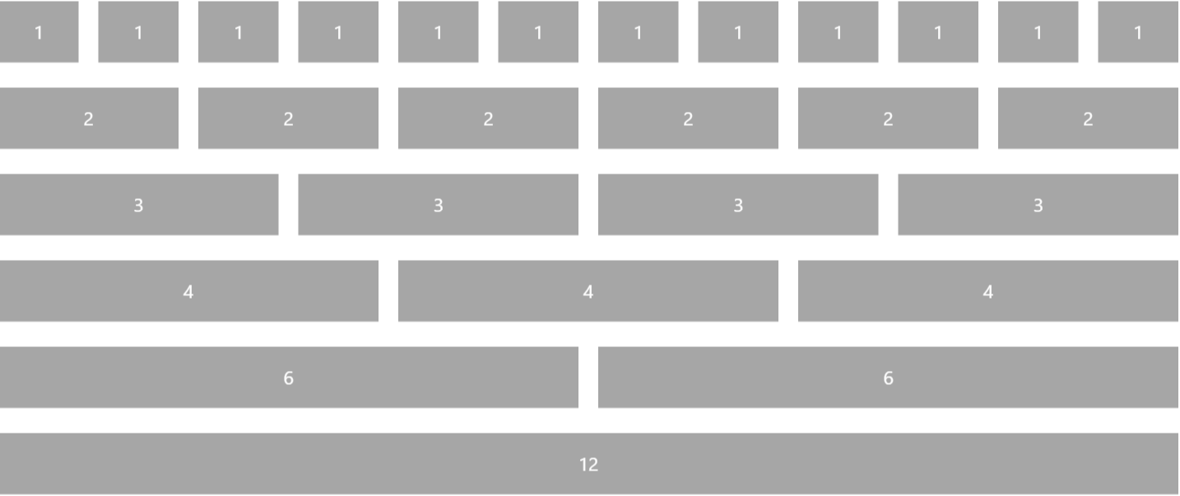
Responsive Grid

Slide 30
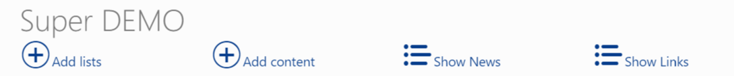
Icons
<div class="ms-Grid">
<div class="ms-Grid-row">
<div class="ms-Grid-col ms-u-md12">
<h1>Super DEMO</h1>
</div>
</div>
</div>
<div class="ms-Grid-row">
<div class="ms-Grid-col ms-u-md2">
<a id="addLists" href="#"><i class="ms-Icon ms-Icon--circlePlus" style="font-size: xx-large" aria-hidden="true"></i>Add lists</a>
</div>

Slide 31
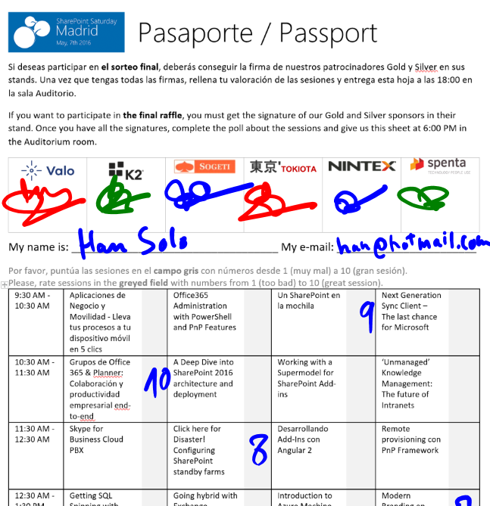
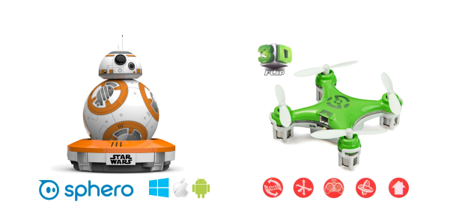
Raffle
Please, fill your SPS Madrid passport if you want to participate.
You must get signature from sponsors and complete the poll.
Give us the passport at 6:00 PM in the Auditorium room.
You can win one Sphero BB-8 or a mini drone:

Slide 32
Notes:
This slide is mandatory. Please do not remove and try to use it during Q&A at the end of your session. Thank you!

